Slide 1
North Africa and Southwest Asia
Combo, emphasizing North Africa
Economic and Cultural Geography

Slide 2
The Arabian Peninsula: Human Geography
ISLAM!
Founded in Mecca
Based on teachings of Muhammad in the Koran (Qur'an)
The Five Pillars
Faith
Prayer
Charity
Fasting
Hajj
Theocracy
Many of the governments linked to a specific religion (Iran)
Religious law

Slide 3
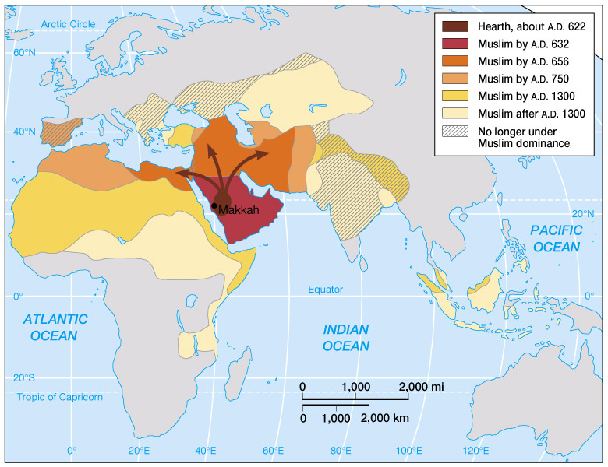
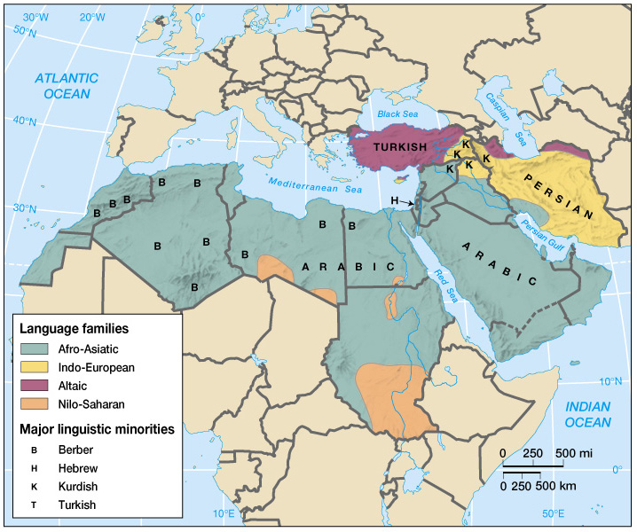
Spread of Islam
Languages of SW Asia and North Africa

Slide 4
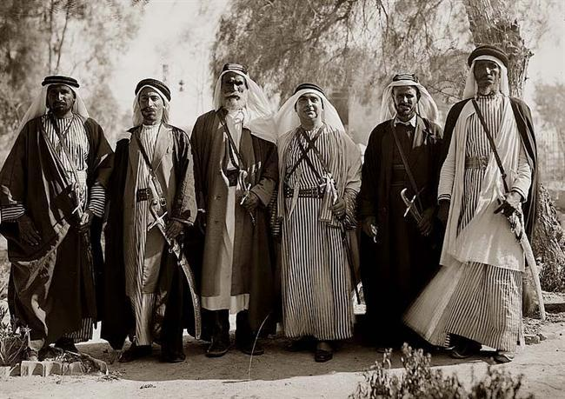
Arab Countries
Some countries in the Middle East and North Africa are referred to as ‘Arab’ countries because the dominant ethnic group is Arab and the major language is Arabic.

Slide 5
Arab Countries
Arab Countries | Non-Arab Countries
Saudi Arabia Oman, UAE Yemen, Qatar Syria, Bahrain Iraq, Jordan North Africa | Israel (Jewish) Turkey Iran

Slide 6
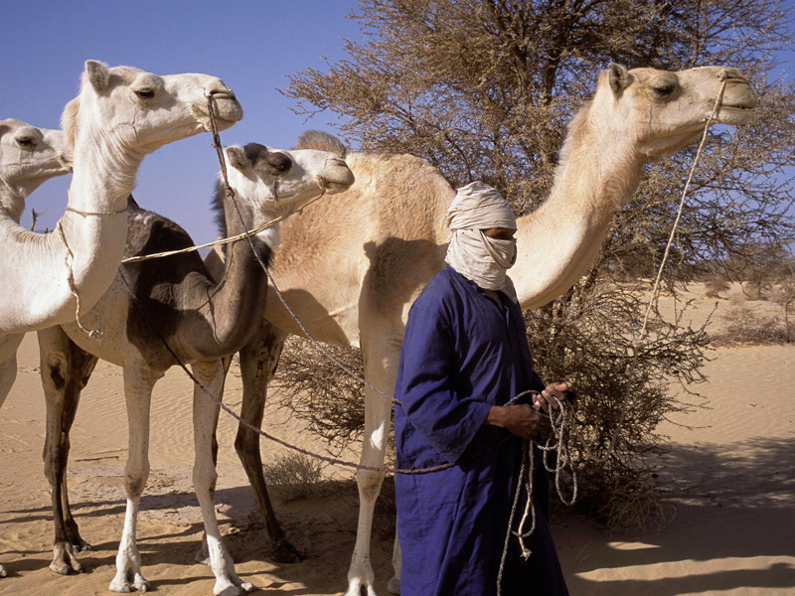
Nomadic Lifestyles
Many people in North Africa and the Middle East still live a nomadic lifestyle. Nomads live on the Arabian peninsula and in the Sahara Desert.

Slide 7
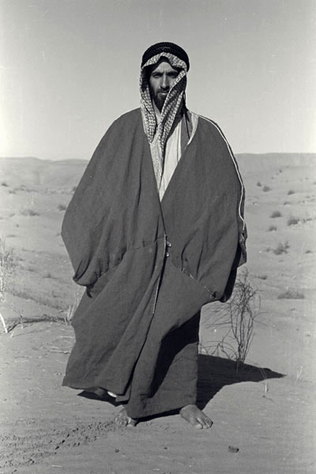

Slide 8
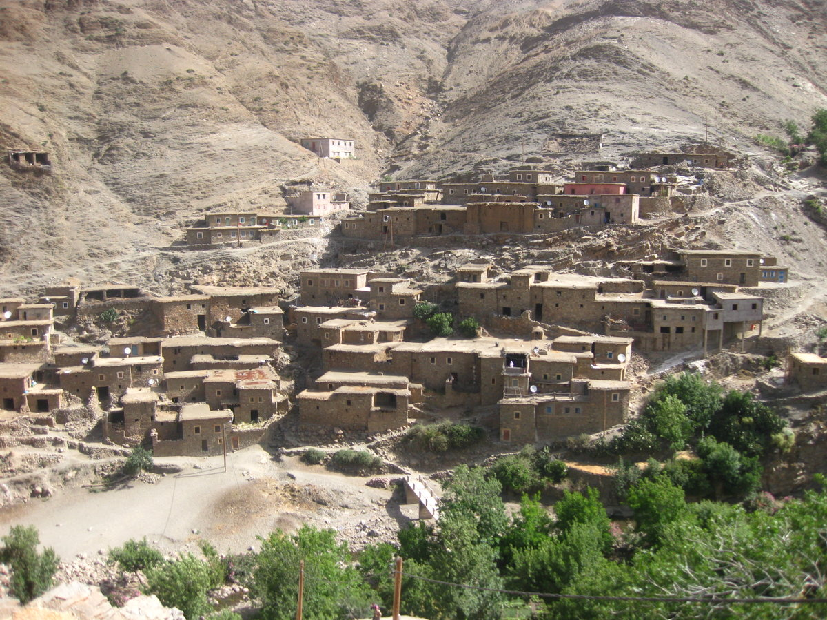
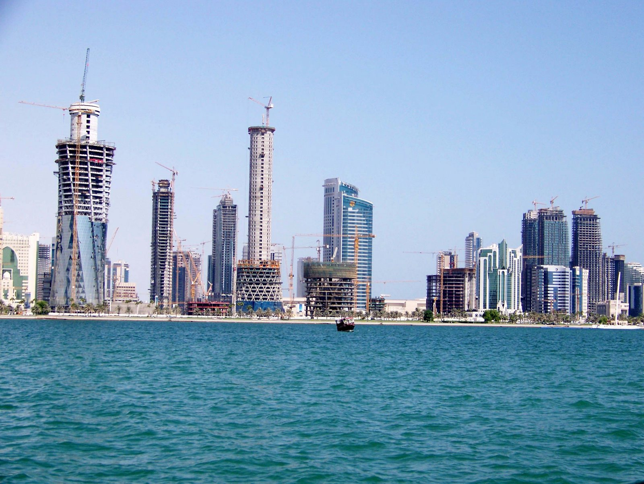
Population
Southwest Asia is becoming rapidly urbanized. People are moving into cities looking for jobs.
Urban areas are very modern but traditional lifestyles in rural areas.

Slide 9
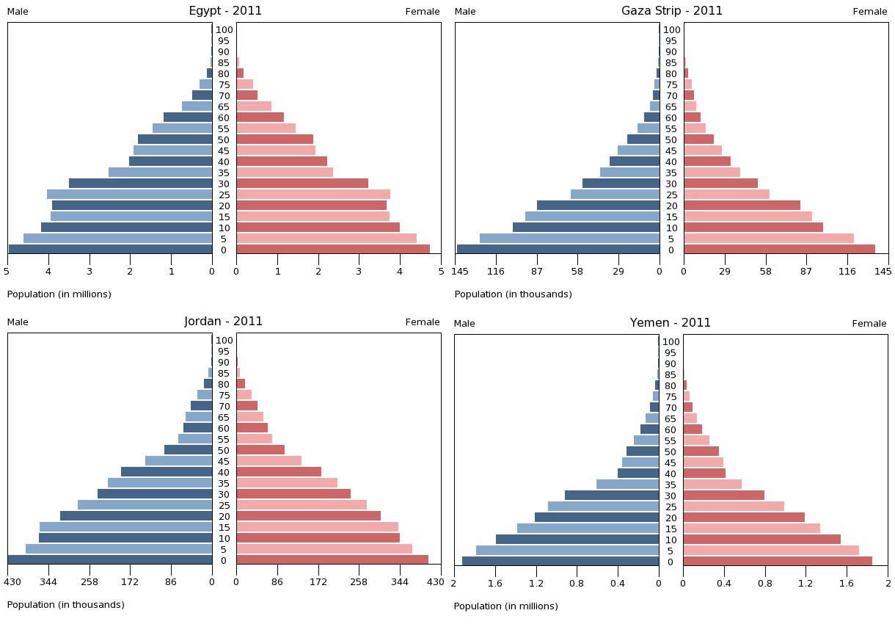
Population
Large percentage is under 15 years old.
Population is unevenly distributed. Large cities are located on the coasts.

Slide 10
Natural Resources
Oil is the major resource in this region.
Many countries in this region are members of OPEC (Organization of Petroleum Exporting Countries).
OPEC sets the price and production of oil and has members all over the world.

Slide 11
Countries With Oil
Countries with oil | Countries that have very little oil
Saudi Arabia Iraq Iran UAE Kuwait Qatar Libya | Israel Turkey Jordan Lebanon Syria Morocco Afghanistan

Slide 12
Positive and Negative
+ | -
1. Oil is valuable 2. Oil money is used to build infrastructure 3. People have a high GDP per capita | Oil fluctuates on the world market Oil will run out eventually

Slide 13
Economic Activity
This region is highly dependent on primary economic activity.
Oil drilling
Agriculture
Pastoralism

Slide 14
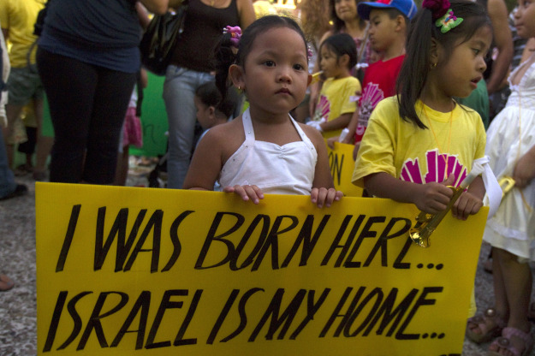
Guest Workers
Countries with oil have small populations. Labor shortage is filled by guest workers from south and east Asian countries.

Slide 15
Aswan High Dam
The Aswan High Dam on the Nile River was completed in 1970. The dam was built to:
Stop seasonal flooding on the Nile River.
Provide hydroelectric power for Egypt.
Provide a steady source of water for irrigation.

Slide 16
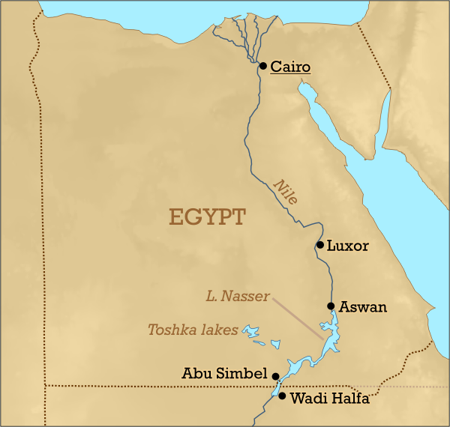

Slide 17
Tourism
Some countries in this region make money from tourism:
Egypt to see the pyramids
Jerusalem to see holy sites (Dome of the Rock, Western Wall)
People visit Mecca (The Hajj)

Slide 18
Developed or Developing?
This region has a wide range of per capita income and levels of development.
High GDP Per Capita | Low GDP Per Capita
Israel - 26,600 Saudi Arabia - 19,800 UAE - 37,000 Qatar - 87,000 Kuwait - 55,900 | Iraq - 3,700 Iran - 11,700 Lebanon - 10,300 Syria - 4,700

